Slide 1
Modulation Techniques And BandWidth Estimation
- Shivam Dixit

Slide 2
What is Modulation?
The process by which data/information is converted into electrical/digital signals for transferring that signal over a medium is called modulation.
Types Of Modulation Techniques
Analog Modulation
Amplitude Modulation
Frequency modulation
Digital Modulation

Slide 3
Analog Modulation
It is a process of transferring analog low frequency signal over a high frequency carrier signal.
In other words, you can say that "Analog Modulation is a technique which is used in analog data signals transmission into digital signals."
Now,
It’s Types

Slide 4
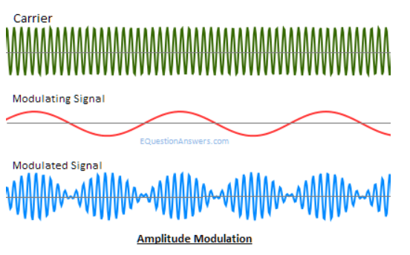
Amplitude Modulation
The process of superimposing the message signal over carrier wave to change the amplitude is called amplitude modulation.

Slide 5
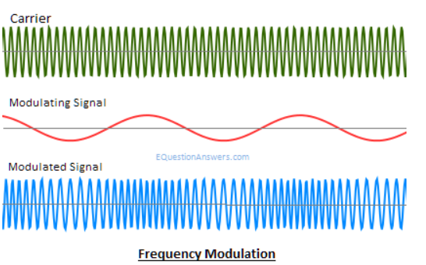
Frequency Modulation
The process of super imposing the message signal over carrier wave t change the frequency is called frequency modulation.

Slide 6
Digital Modulation
Digital Modulation is a technique in which digital signals/data can be converted into analog signals.
The carrier wave is keyed or switched on and off to create pulses such that the signal is modulated.
The types of digital modulation are based on the type of signal and application used such as Amplitude Shift Keying, Frequency Shift Keying.

Slide 7
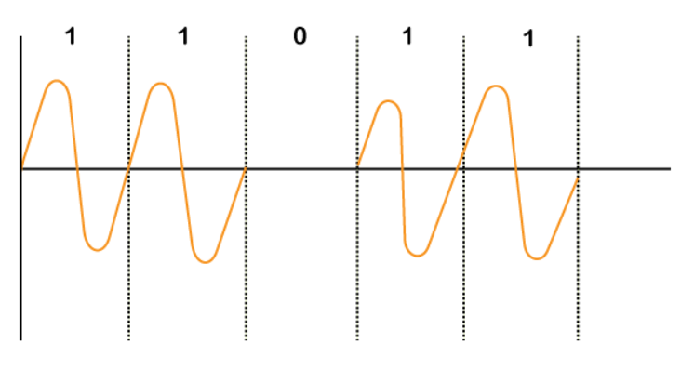
Amplitude Shift Keying
As the name suggests, in Amplitude Shift Key the amplitude is represented by "1," and if the amplitude does not exist, it is represented by "0".

Slide 8
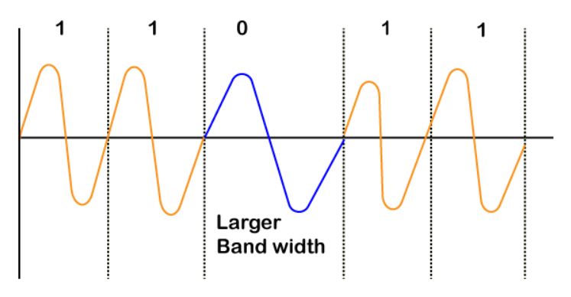
Frequency Shift Keying
In Frequency Shift Key or FSK Modulation, different notations f1 and f2 are used for different frequencies. Here, f1 is used to represent bit "1," and f2 represents bit "0".

Slide 9
BandWidth Estimation
In a packet network, the terms bandwidth often characterize the amount of data that the network can transfer per unit of time.
Bandwidth estimation is of interest to users wishing to optimize end-to-end transport performance, overlay network routing, and peer-to-peer file distribution.
Existing bandwidth estimation tools measure one or more of three related metrics: capacity, available bandwidth, and bulk transfer capacity.

Slide 10
Thank You

